Slide 1
Delegation and Decentralization

Slide 2
Ref: Chapter 11, Organization and Management By R.D Agarwal
Delegation:
Delegation is the primary mechanism through which organization work is distributed among its employees, authority is vested in them for performance of assigned tasks, and obligation is imposed on them to perform adequately.

Slide 3
Objectives of Delegation:
Less important work need not to done by executives. He can devote more time on important areas of his duties like planning, co-ordination and control.
Develop the subordinate to take more responsibilities
Push lowest level to make decision making
Motivate the subordinate.

Slide 4
Advantages of Delegation:
Enhancement of organizational effectiveness
Frees from less important work
Tool of employee and development and motivation
Decisions are likely to be more timely and realistic

Slide 5
Obstacles to Effective Delegation:
Superior related reasons
Belief that he can make better decisions
Fear of losing importance
Fear of loss of control
Fear of being exposed
Tendency to be autocratic
Unwillingness to take risks

Slide 6
Obstacles to Effective Delegation:
Subordinate related reasons
Lack of self confidence
Fear of making mistake
Dependent personality
Unclear delegation
Lack of motivation

Slide 7
Principles of Effective Delegation:
Authority should be commensurate with responsibility
Interference should be minimum
Tolerances of mistakes
Adequate controls should be established
Goals should be predetermined
Policies, Rules and Procedures should be establish to guide decision
Upward delegation should not be allowed
Delegation should be rewarded.

Slide 8
Decentralization:
Decentralization:
Decentralization means wide distribution of authority throughout the organization so that managers at various levels have adequate authority to make their job related decisions.

Slide 9
Principles of Decentralization:
Role of Top management should be defined
Centralized controls and measurements should be established
Authority of division should be clarified
Balance should be defined between decentralization and centralization

Slide 10
Advantages of Decentralization:
Frees top management from operational responsibility
Manager Development
Better and Speedier decision
Permits management by objectives and self control

Slide 11
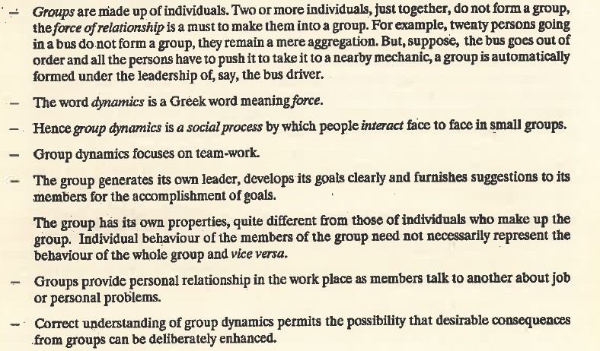
Group Dynamics:

